Slide 1
DDJ-1000 Traktor mapping installation
This work requires the “BOME Midi translator Pro” third-party software
Steps are first explained, then shown via screenshots. Do not skip any step!
See also the installation FAQ (on a separate pdf file).

Slide 2
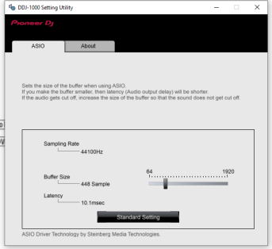
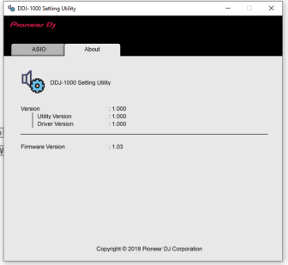
Step #0
CONFIRM THAT REKORDBOX DJ WORKS IN YOUR SYSTEM!
Driver Download: https://www.pioneerdj.com/en/support/software/controller/ddj-1000/#drivers
Firmware download: https://www.pioneerdj.com/en/support/software/controller/ddj-1000/#firmware-update
Rekordbox DJ download: https://rekordbox.com/en/

Slide 3
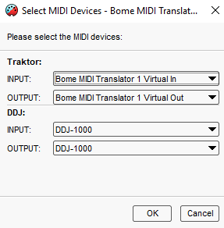
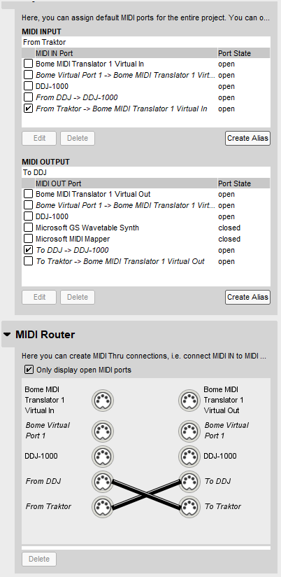
TRAKTOR DJ Software
AUDIO path
DDJ-1000
OS Driver
USB
TSI FILE (6 sub pages)
MIDI path
out port
DDJ-1000
in port
BMT1
From Traktor
To DDJ
To Traktor
BMTP file (7 presets)
From DDJ
BOME MIDI Translator
Settings
BMTS file

Slide 4
Step #1
BOME-MAP INSTALLATION do not skip any step!

Slide 5
PRELIMINARIES:
Stop Rekordbox
Stop Traktor
Expand all files in the zip file
Connect the USB cable
Turn on your DDJ-1000.
Download and Install the BOME trial from https://www.bome.com/products/miditranslator#downloads
INSTALLING BOME MAPPING:
Open BOME. DO NOT RUN TRAKTOR!
Settings: Import the settings file
Method: menu View; settings; export/import; import; select BMTS file
Mapping: load the mapping file
Method: Click menu File; Open; select BMTP file
Do not mix up the Settings file with the Mapping file!
Beware!

Slide 6
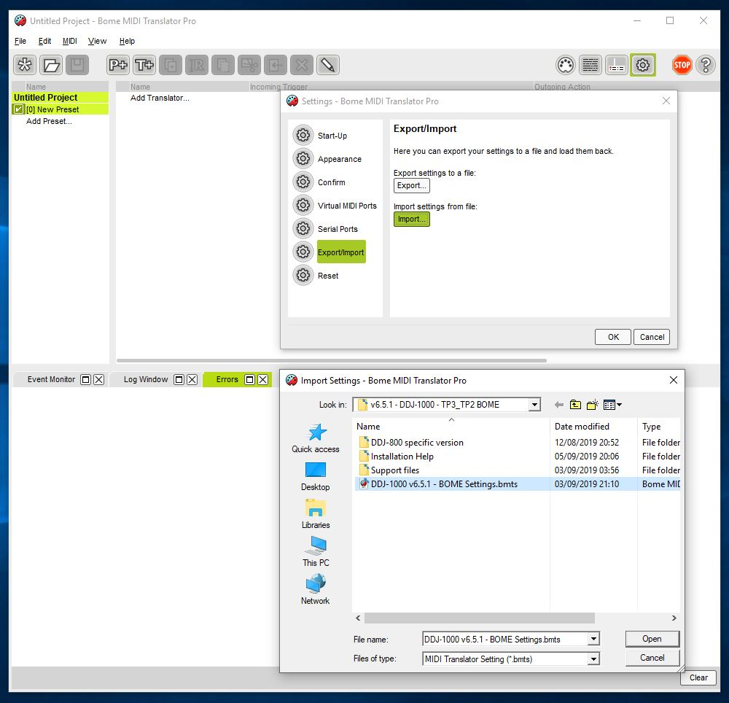
BOME: import settings file (BMTS file)

Slide 7
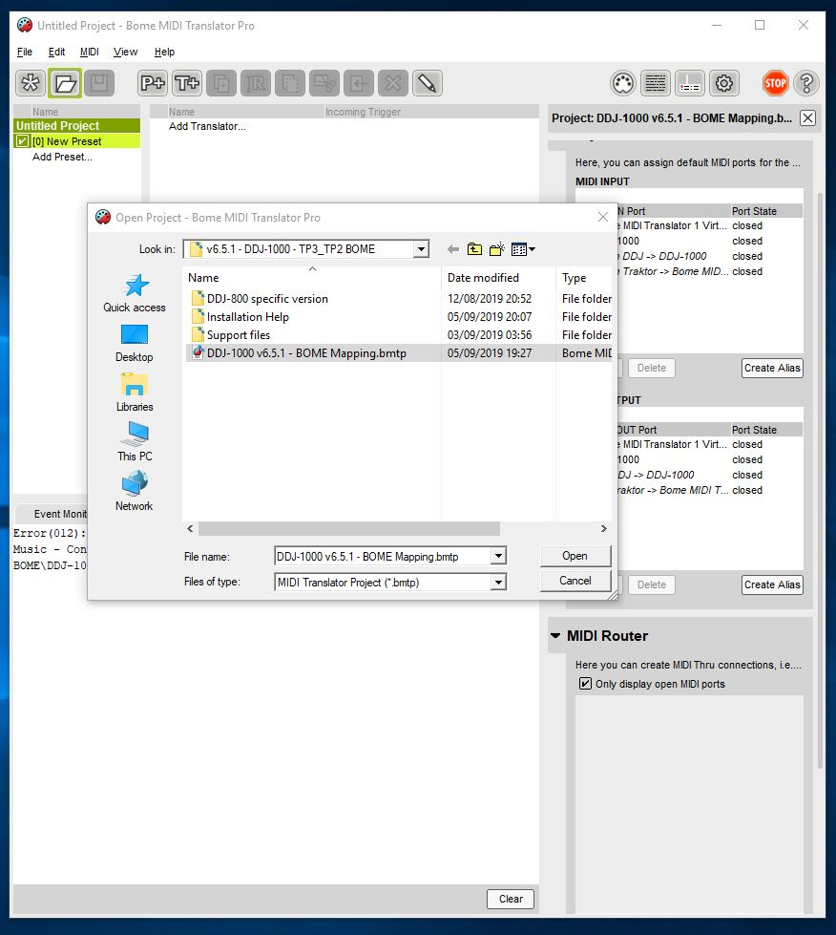
BOME: import mapping file (BMTP file)

Slide 8
BOME: Aliases

Slide 9
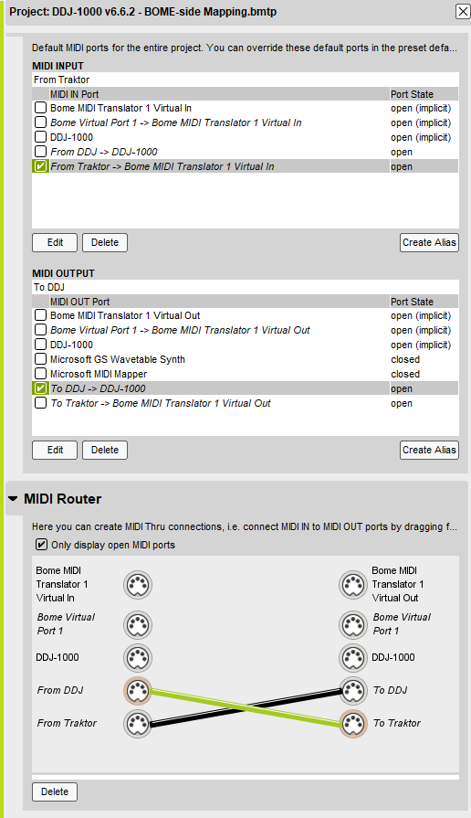
BOME: Devices
Confirm the devices are OPEN!
Ensure ONLY these 2x options are checked:
- “From Traktor” -> device 1 in OPEN - “to DDJ” -> DDJ-1000 OPEN
Confirm it looks EXACTLY like on the picture
Confirm this “cross” on EXACTLY these aliases

Slide 10
Step #2
BOME-MAP VERIFICATION
do not skip any step!

Slide 11
BOME VERIFICATION STEPS:
Confirm the “Bome MIDI Translator 1” device is created (longformat)
Method: menu View ; settings ; virtual midi ports ; 1 port; long port names
Confirm the 4x midi ports were opened correctly
Method: Click log window; check log
Confirm that the Controller talks to BOME
Method: Click log window; click “MIDI-IN/OUT”; Press any button on the controller; confirm they appear in the log file; unclick “MIDI-IN/OUT”
Confirm that the BOME clock is running
Method: Click log window; click “rules”; see a lot of messages appearing
unclick “rules” to stop loggin
Minimize BOME to keep it running

Slide 12
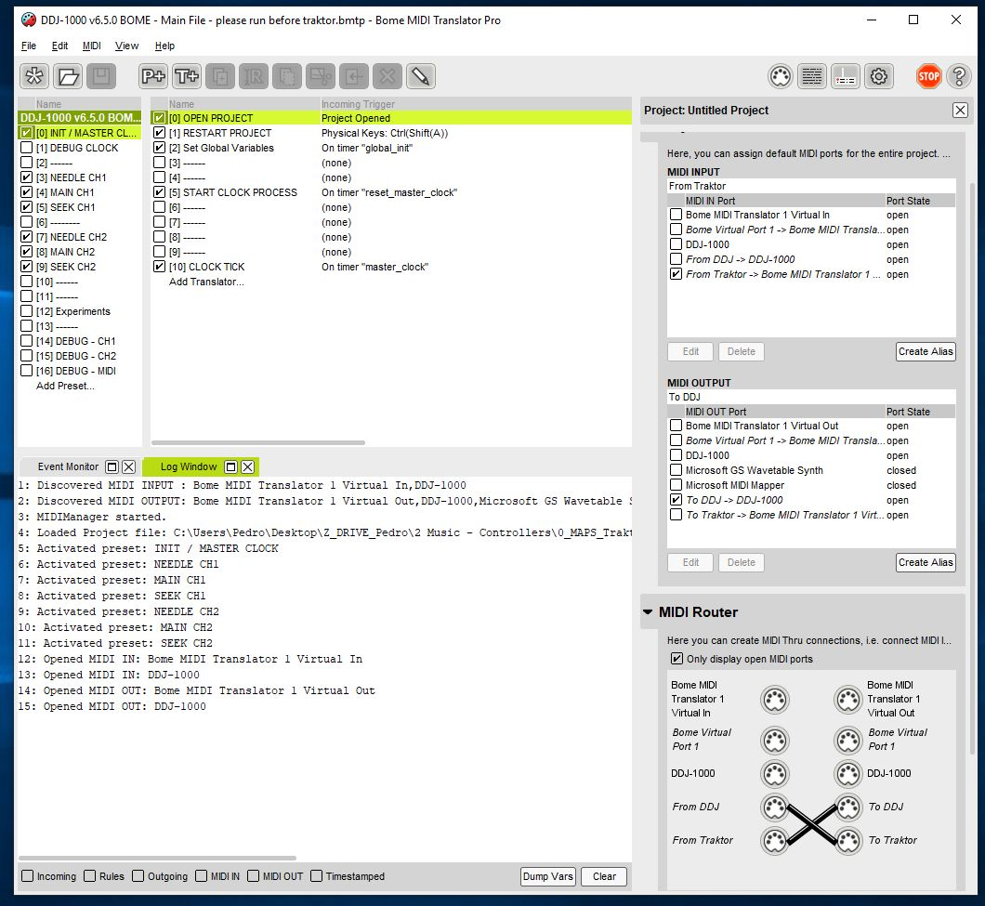
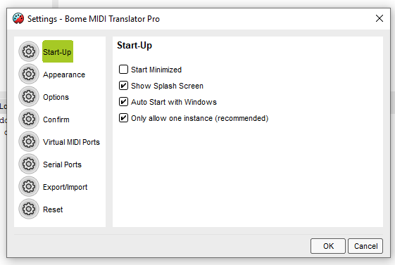
BOME settings: auto start with windows
Auto start with Windows!

Slide 13
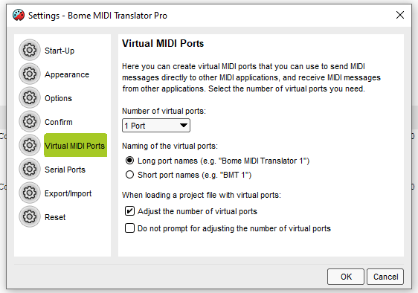
BOME settings: long port name device
Long port names!

Slide 14
BOME: Correct startup log
Do not change this! Default is ONLY - “From Traktor” OPEN - “to DDJ” OPEN confirm devices are OPEN!
4x messages here!
Do not change this “cross”!

Slide 15
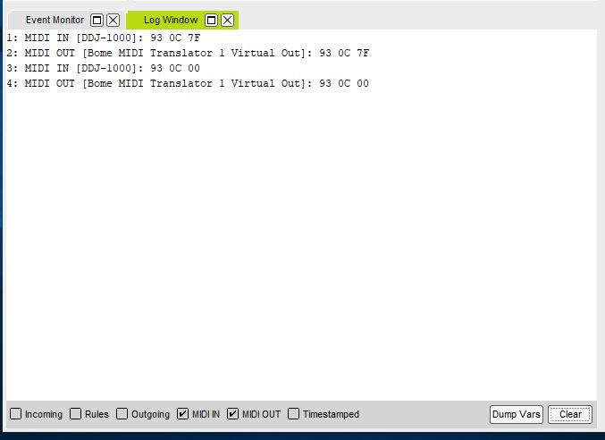
BOME: confirm DDJ talks to BOME
Pressing and releasing any button generates 4 log lines. This is always in the DDJ->BMT1 direction
Activate MIDI debug here

Slide 16
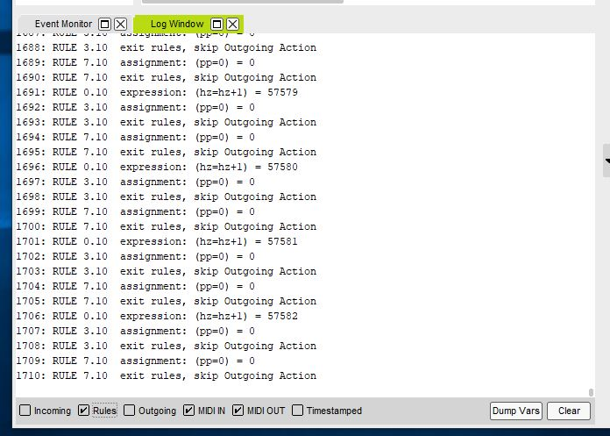
BOME: confirm internal clock
HZ goes up one by one continuously
Activate rules debug here
(Please click “rules” again to stop the logging)
Tip!

Slide 17
Step #3
TRAKTOR-MAP INSTALLATION do not skip any step!

Slide 18
CREATE A BACKUP:
Note: the mapping replaces a lot of your settings. In any cases, Traktor always makes automatic backups in “Root_Dir\Backup\Settings”
Open Traktor
Click Settings
Click big “export button” on lower left corner
Ensure all settings are clicked
Save the file
INSTALL TRAKTOR MAPPING:
Click Settings
Click big “import button” on lower left corner
Accept all checks; PLUS additionally click the “Audio device settings”
INSTALL TRAKTOR MAPPING (second time):
Repeat above process a second time. This is only to avoid a Traktor bug that gets the FX list wrong.
Extra click

Slide 19
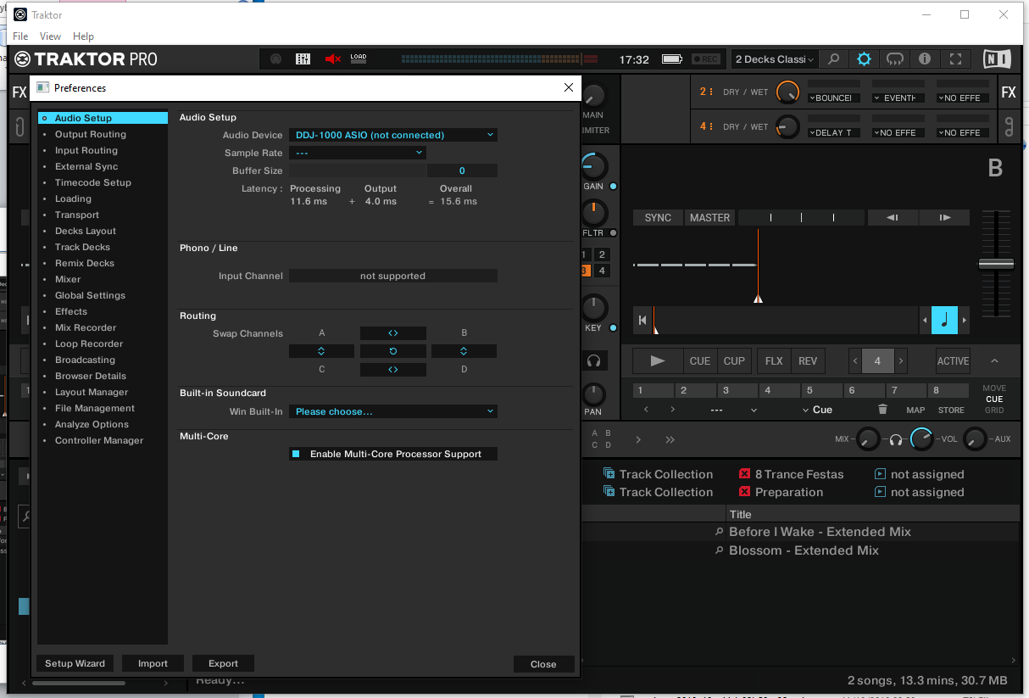
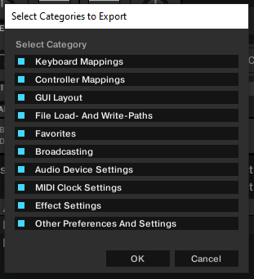
TRAKTOR: create backup of your settings
Backup everything!

Slide 20
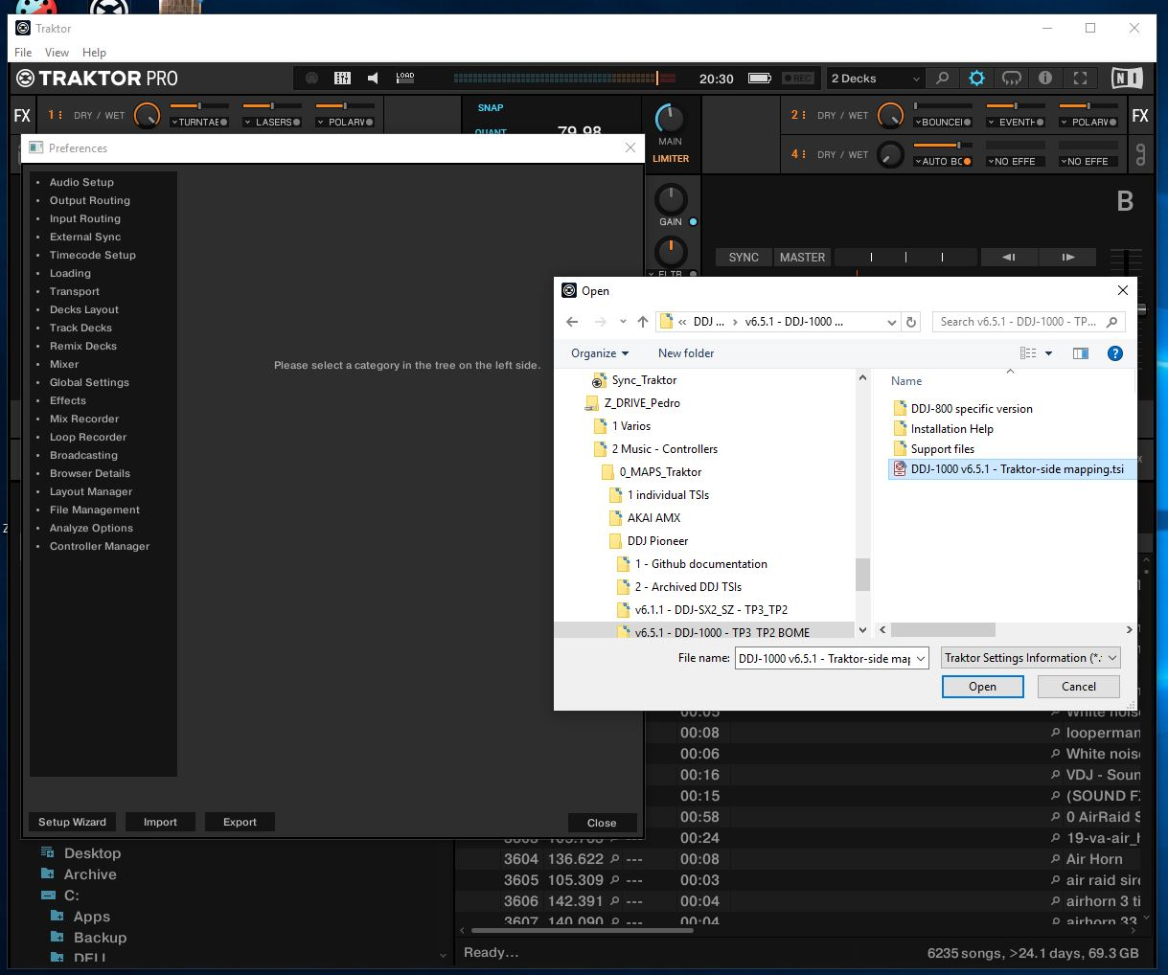
TRAKTOR: import mapping

Slide 21
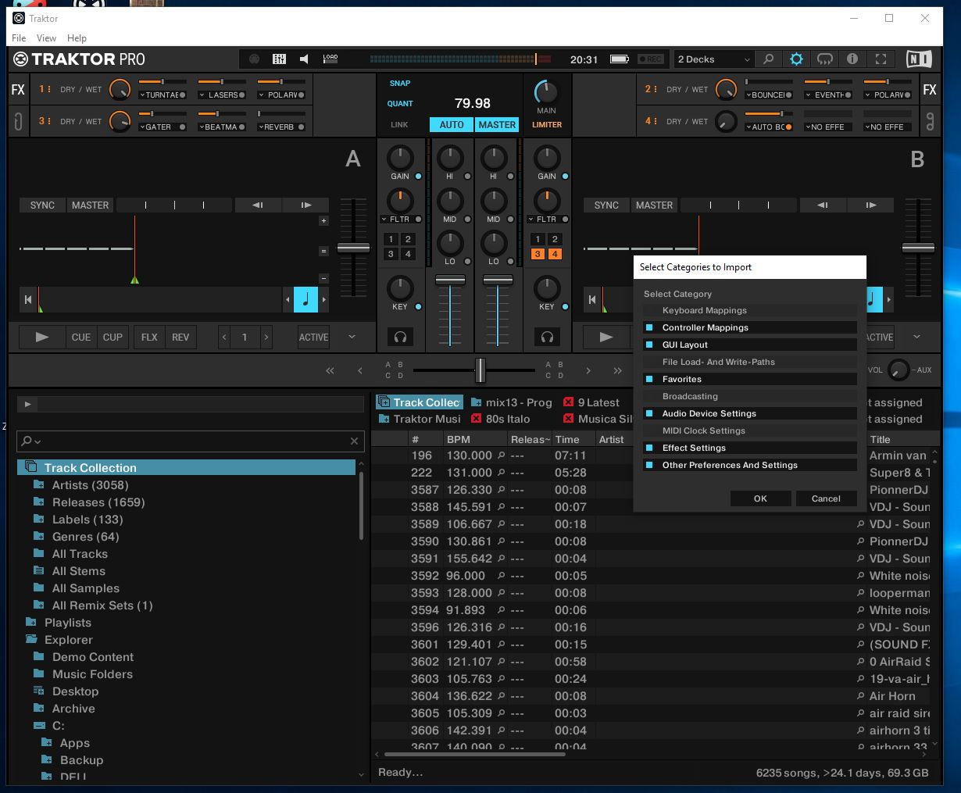
TRAKTOR: click audio device config
Please include this one as well

Slide 22
TRAKTOR: import mapping (second time)

Slide 23
Step #4
TRAKTOR-MAP VERIFICATION do not skip any step!

Slide 24
TRAKTOR VERIFICATION:
Note: the Preferences window is now quite slow to open. This is another Traktor bug.
Confirm the audio device is “DDJ-1000 ASIO”
Method: Settings ; audio setup ; confirm audio device
Confirm the Output routing
Method: Settings ; output routing; confirm “internal”; confirm “3 / 4 / 1 / 2”
Confirm that all 6x pages have exactly “Bome Midi Translator1”
Method: Settings; controller manager; click each of the 6x pages one-by-one; check IN and OUT port
DO NOT CHANGE TO DDJ-1000 in the controller manager!!!
DO NOT FORGET TO CONFIRM ALL 6x PAGES!
Verify that sound is played
Method: Load a track; click Cue and play/pause repeatedly
Use shift+quantize to send a reset command to BOME
Verify that BOME sees all the messages
Method: open the bome window; click the “CUE” button; verify that the BOME log displays at least 8x log lines per human click
Beware #1!
Beware #2!

Slide 25
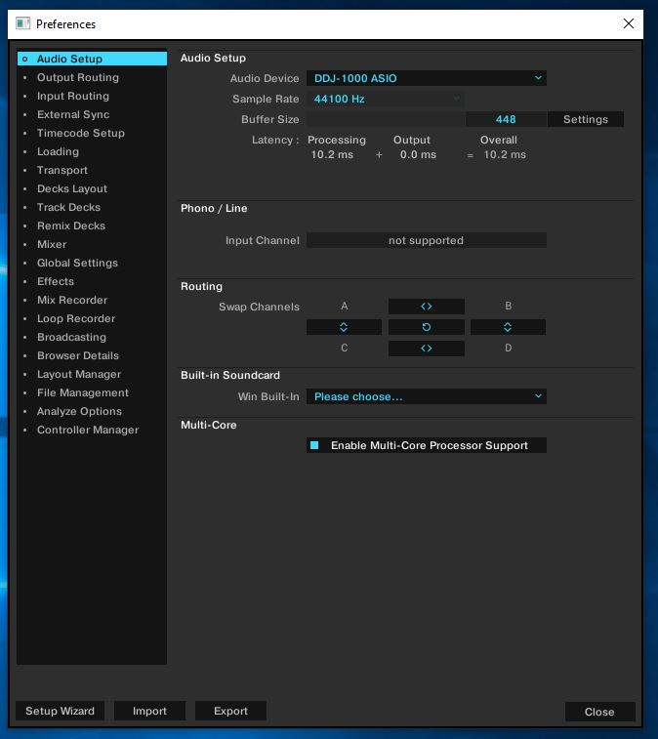
TRAKTOR: check audio device

Slide 26
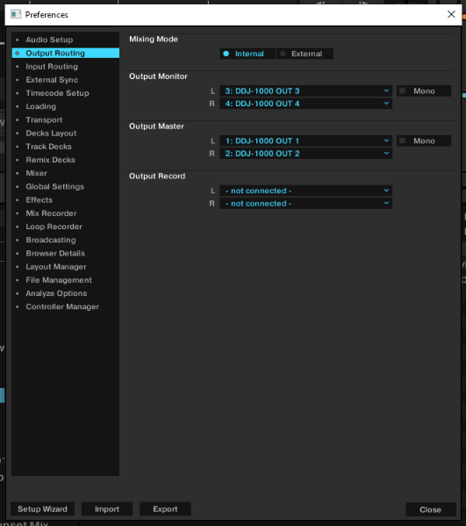
TRAKTOR: check output routing
Configure your channels with 3 / 4 / 1 / 2

Slide 27
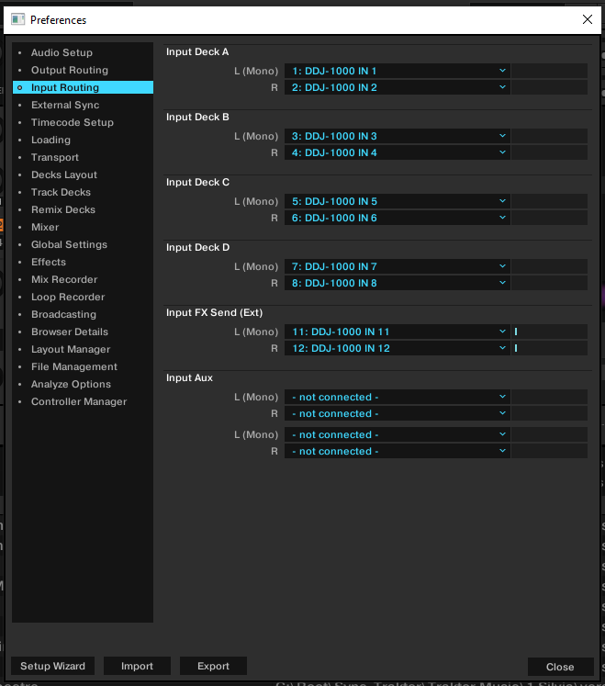
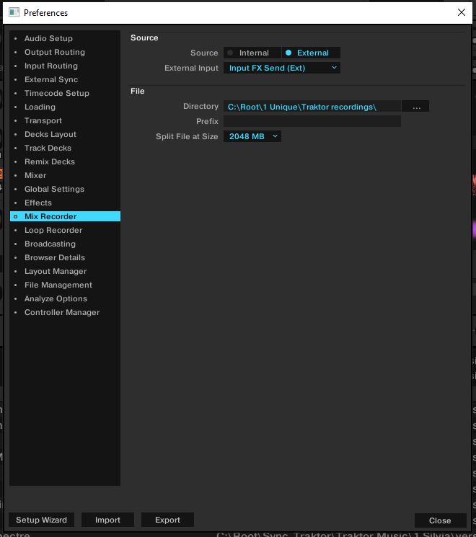
TRAKTOR: how to record Traktor + CDJs

Slide 28
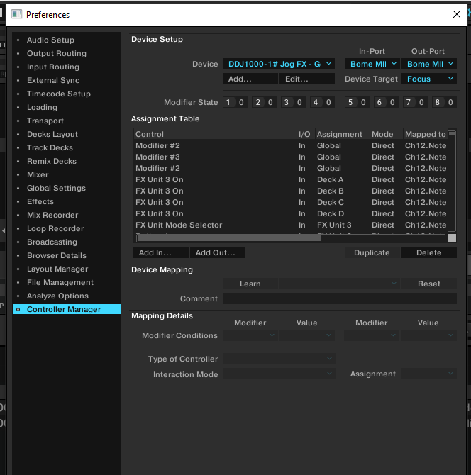
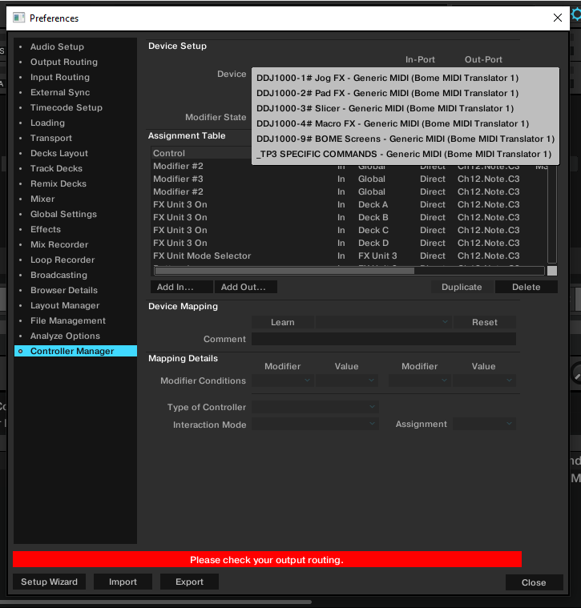
TRAKTOR: check MIDI device is long format
first click here
Both IN and OUT = Long format For ALL 6 PAGES!

Slide 29
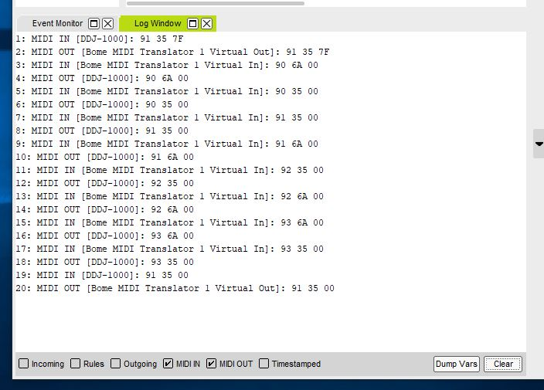
BOME: confirm bidirectional flow
Pressing and releasing any button generates at least 8x log lines. This is both in the DDJ->BMT1 direction and the BMT1->DDJ direction
Stop “rules” log

Slide 30
IF ITS STILL NOT WORKING #1
Re-confirm you have the “Bome midi Translator 1” on all 6x pages.
Re-confirm the DDJ-1000 is the audio device and is on the output/input routing
Advanced: Try setting the device to forced MIDI mode (page 26 of the DDJ-1000 manual) Steps: no USB cable, power off, left Play + Shift+Turn on, left Slip Reverse ON; power ON, insert USB cable.

Slide 31
IF ITS STILL NOT WORKING #2
Make a HD video of the verification steps, INCLUDING THE BOME LOG.
Upload the video to https://wetransfer.com so that I can read the small text Send an email to pedro.estrela@gmail.com

Slide 32
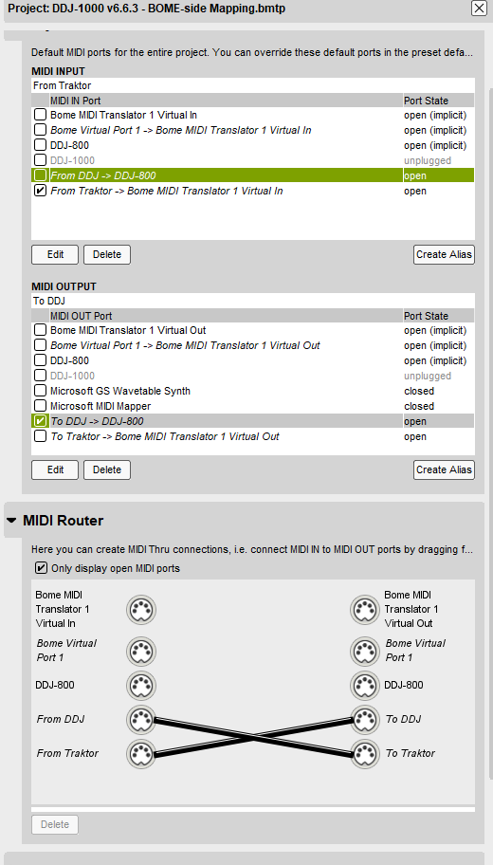
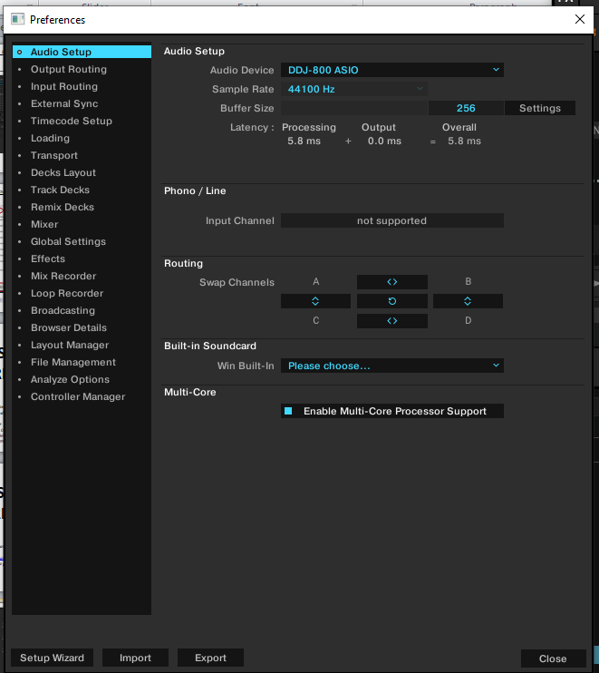
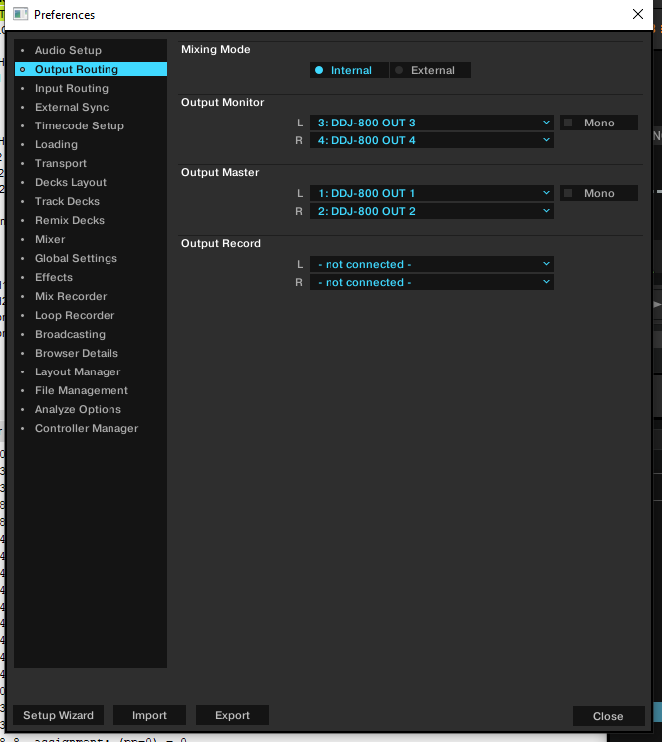
ANNEX: DDJ-800

